Slide 1


May M
May 22, 2024
How to subdivide,
How not to subdivide.
And .. We have some answers!
That is the Question…

Slide 2

Subdivision Ordinance Technical Assistance Consultants
Consultant | Profession | Contact Information | Hourly Rate
Hansen Planning Group / Rural Community Consultants | Planner | Mike Hansen 801-550-5075 mike@hansenplanninggroup.com | $150.00
Hayes Godfrey Bell, PC | Attorney | Todd J. Godfrey 801-272-8998 tjgodfrey@hgblaw.net | $215.00
Planning Outpost | Planner | Valerie Claussen (385) 432-6262 val@planningoutpost.com | $150.00
Smith Hartvigsen | Attorney | Adam S. Long 801-413-1600 along@shutah.law | $250.00
 | Attorney | Lisa Watts Baskin (801) 413-1600 lwbaskin@shutah.law | $250.00
 | Attorney | Jay L. Springer 801-413-1600 jspringer@shutah.law | $210.00

Slide 3
Sunrise Engineering | Planner | Daniel Jensen, JD, AICP 801.592.9599 daniel.jensen@sunrise-eng.com | $150.00
 | Planner | Lance Evans, AICP 801.654.8004 Lance.evans@sunrise-eng.com | $150.00
Landmark Design | Planner | Sam Taylor 801-474-3304 samt@ldi-ut.com | $150.00
 |  | Mark Vlasic, AICP 801-474-3300 markv@ldi-ut.com | $150.00
Logan Simpson Design | Planner | Sophie Frankenburg,AICP 801-364-0525 sfrankenburg@logansimpson.com | $150.00
DWS – Housing and Community Development Dept. jobs.utah.gov/housing/community/subpool.html

Slide 4
Let’s start from the beginning
Create the Subdivision Ordinance
Planning Commission Hearing then City Council thumbs up, modify or deny
For the Update by Dec. 31, 2024 you will be amending the Subdivision Ordinance
Follow the same process as creation of an ordinance

Slide 5
If you choose to do Plat Exemptions they Must be in your Ordinance
10-9a-605 Exemptions from plat requirement. (1) Notwithstanding any other provision of law, a plat is not required if: (a) a municipality establishes a process to approve an administrative land use decision for a subdivision of 10 or fewer lots without a plat; and (b) the municipality provides in writing that:
the municipality has provided notice as required by ordinance; and (ii) the proposed subdivision:
(A) is not traversed by the mapped lines of a proposed street as shown in the general plan unless the municipality has approved the location and dedication of any public street, municipal utility easement, any other easement, or any other land for public purposes as the municipality's ordinance requires;
(B) has been approved by the culinary water authority and the sanitary sewer authority;
(C) is located in a zoned area; and
(D) conforms to all applicable land use ordinances or has properly received a variance from the requirements of an otherwise conflicting and applicable land use ordinance.

Slide 6
Ag Exemption
Subject to Subsection (1), a lot or parcel resulting from a division of agricultural land is exempt from the plat requirements of Section 10-9a-603 if the lot or parcel:
(i) qualifies as land in agricultural use under Section 59-2-502;
(ii) meets the minimum size requirement of applicable land use ordinances; and
(iii) is not used and will not be used for any nonagricultural purpose.

Slide 7
Subdivision Process Changes
Last year SB 174…….This year HB476
Process Changes only applies to subdivisions for 1- or 2-family dwellings, townhomes
Resources available on ULCT.org under the Advocacy tab
State Code : Title 10 Chapter 9a Part 6 – le.Utah.gov

Slide 8
Subdivision Approval Process Changes (SB174) 2023
New LUDMA Sections
604.1.& 604.2
Title 10
Chapter 9a
You must designate an “administrative land use authority” – prelim & final
"administrative land use authority" means an individual, board, or commission, appointed or employed by a municipality, including municipal staff or a municipal planning commission.
A Land Use Authority may complete preliminary plat review by staff, or in public meeting; may hold one public hearing at Planning Commission
Deals with preliminary and final plats only
Applicant may request pre-application meeting- can’t mandate- 15 day review
Complete application triggers the review process
Final plat cannot be reviewed or approved by City Council or Planning Commission

Slide 9
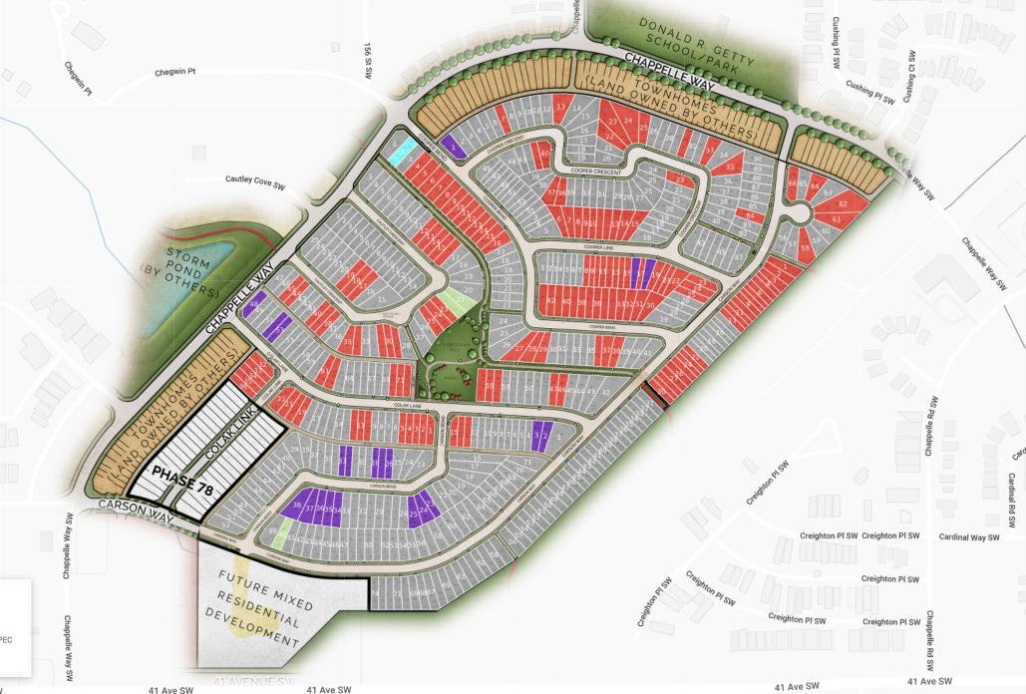
Subdivision Review Process (HB476) 2024
This year the Subdivision Code “Cleanup” dealt with:
Subdivision Improvement Plan submissions
Preliminary vs. Final Engineering Plans- clarification
Timing of reviews- extended time for smaller communities and towns

Slide 10
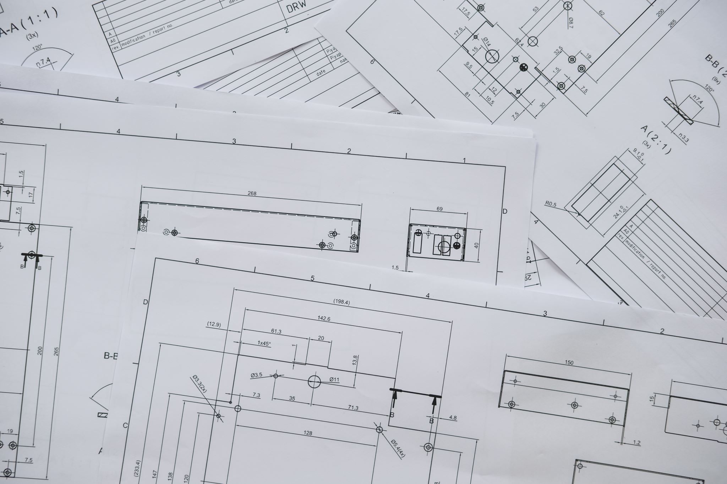
Subdivision Improvement Plan submissions
Decision Point
• A municipality may not require a subdivision improvement plan ( civil engineering) to be submitted with both a preliminary subdivision application and a final subdivision application.
So, pick one or the other…

Slide 11

Timing of reviews
Decision Point
Subdivision application review: (if no improvement plan or small – your call)
A municipality shall complete the initial review of a complete subdivision application submitted for ordinance review for a residential subdivision for single-family dwellings, two-family dwellings, or town homes: (i) no later than 15 business days after the complete subdivision application is submitted, if the municipality has a population over 5,000; or
(ii) no later than 30 business days after the complete subdivision application is submitted, if the municipality has a population of 5,000 or less.

Slide 12
Timing of reviews
Decision Point
Subdivision application review: Has engineering plans, larger or more complex
A municipality shall complete a subdivision plan review of a subdivision improvement plan that is submitted with a complete subdivision application for a residential subdivision for single-family dwellings, two-family dwellings, or town homes within 20 business days after the complete subdivision application is submitted, if the municipality has a population over 5,000;
or within 40 business days after the complete subdivision application is submitted, if the municipality has a population of 5,000 or less.

Slide 13
Subdivision Improvement Plan submissions
The 20 day review cycle requirements for redlines apply to the review of a preliminary subdivision application, if the municipality requires a subdivision improvement plan to be submitted with a preliminary subdivision application;
or to the review of a final subdivision application, if the municipality requires a subdivision improvement plan to be submitted with a final subdivision application.

Slide 14
A municipality may not require more than four review cycles for a subdivision improvement plan review. The cycle applies to what you decided in this area.
(i) to the review of a preliminary subdivision application, if the municipality requires a subdivision improvement plan to be submitted with a preliminary subdivision application;
or (ii) to the review of a final subdivision application, if the municipality requires a subdivision improvement plan to be submitted with a final subdivision application.
20 days in each cycle- do not have to do all 4 cycles – can stop or appeal at any point if 20 days passes and no compliance

Slide 15


Slide 16


Contact ULCT
Cameron Diehl,
Executive Director
cdiehl@ulct.org
Todd Godfrey
Land Use Legal Guru
tjgodfrey@hgblaw.net
Meg Ryan,
Land Use
mryan@ulct.org

